Slide 1


Slide 2
Mental Health & Prefab Projects – USVI
Overview of modular construction and innovative mental health initiatives in the U.S. Virgin Islands

Slide 3
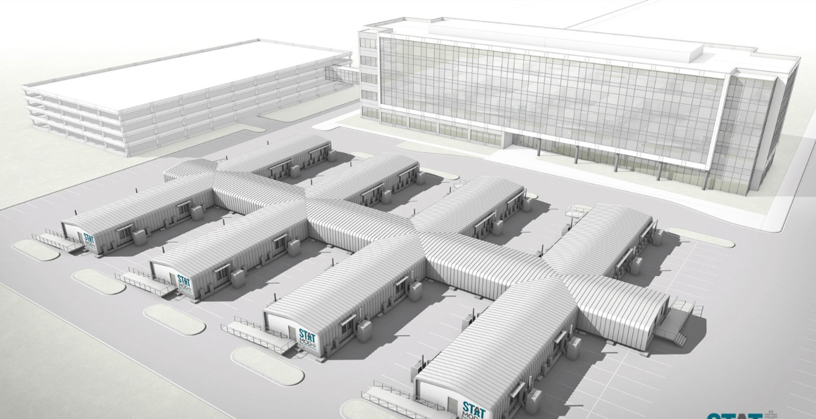

Slide 4
Context & Challenges
Post-hurricane recovery
Limited healthcare infrastructure
Rising mental health needs (PTSD, anxiety, substance use)
Geographic and access barriers

Slide 5
Prefab Construction Advantage
Rapid deployment
Cost-effective
Disaster-resilient
Scalable and relocatable
Minimizes site disruption

Slide 6
Modular Interim Health Center – St. Croix
40,000 sq ft facility
66 modular units
Built by Modular Genius
Supports Department of Health
Includes behavioral health services

Slide 7
Key Benefits of Modular Health Facilities
Quick installation
Immediate usability
Flexible design
Supports integrated care
Ideal for disaster recovery

Slide 8
Permanent Facilities in Development
Donna M. Christensen Health Center
Eldra Schulterbrandt Mental Health Facility
Anna’s Hope Behavioral Health Facility
Resilient and comprehensive care models

Slide 9
Proposed Initiative: REACH-USVI Platform
Telehealth & digital coordination
Multilingual & mobile-first
AI symptom tracking
Connects to crisis services (988)
Improves access across islands

Slide 10
Eco-Therapy & Community Hubs
Nature-based healing programs
Group therapy & mindfulness
Climate resilience education
Targets PTSD and community stress

Slide 11
Youth Healing Network
School-based mental health programs
Trauma-informed education
Peer support systems
Suicide prevention initiatives

Slide 12
Mobile Behavioral Health Units
On-site crisis response
Van/mobile clinic model
Reduces ER burden
Supports remote communities

Slide 13
Public Awareness Campaign
“Healthy Minds, Strong Islands”
Reduce stigma
Community engagement
Workplace & faith-based training

Slide 14
Future Opportunities
Prefab outpatient clinics
Youth wellness centers
Community resilience hubs
Expanded mobile services

Slide 15
Conclusion
Combining prefab infrastructure with innovative programs can transform mental health care in USVI

