Slide 1
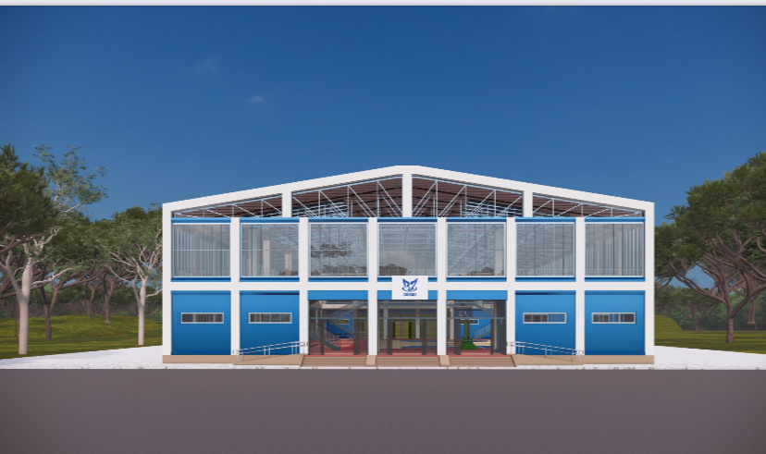




Prepared By:
B7 Globals

Slide 2

About B7 Globals LLC
B7 Globals LLC is a Delaware-registered, USA-based company committed to advancing sustainable and environmentally responsible solutions across multiple sectors. With a wide-reaching presence in the Caribbean, we specialize in sourcing and delivering cutting-edge products and services in renewable energy, transportation, smart construction, sports infrastructure, and water treatment.
Our company plays a strategic role in supporting government and private sector efforts to reduce carbon emissions, lower energy costs, and modernize infrastructure. From electric buses and smart villas to solar energy systems and FIFA/FIBA-certified sports facilities, B7 Globals is driving the future of sustainable development.
Through strategic alliances—such as our partnership with Flyon Sports for stadium infrastructure and our joint venture with MillWood Construction in St. Lucia—we bring together world-class sourcing with local expertise. This collaborative approach allows us to manage entire project lifecycles, from concept and supply to construction and delivery.
B7 Globals is not only a supplier—we are a solutions provider, helping shape resilient, eco-friendly communities across the Caribbean.

Slide 3
Mission
To aid in providing a sustainable solution for FIBA approved facilities which are cost effective and efficient. The main goal for these facilities is to aid in the development of basketball in the caribbean and create more opportinities for scholarships and revenue in the participating countries.

Slide 4
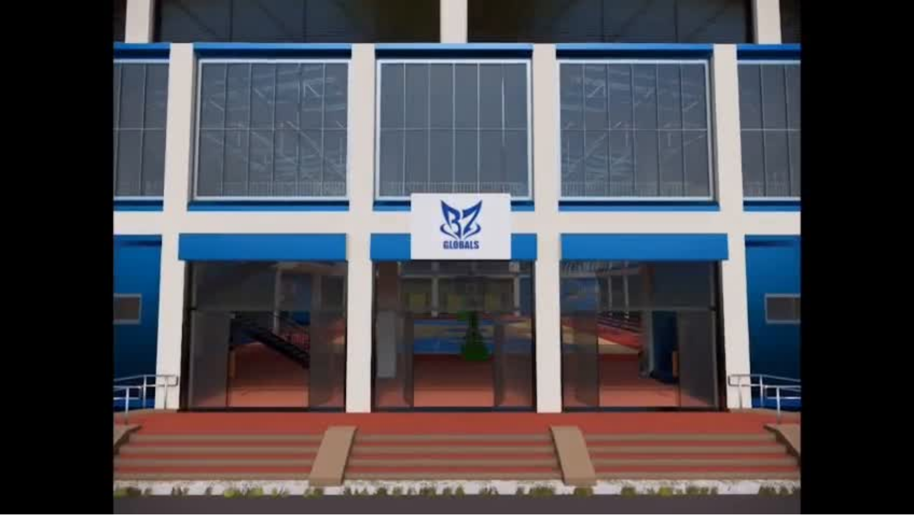

Slide 5
1. Project Overview and Specifications
Structure Specifications
  Size: 10,000 sq ft total (approximately 100 ft x 100 ft or similar footprint to accommodate a regulation court and additional amenities).
  Type: Pre-engineered steel building (prefab) for cost efficiency, durability, and quick assembly.
  Ceiling Height: Minimum 22.96 ft (per indoor basketball court standards), ideally 27 ft to ensure clearance for jump shots and lighting fixtures.
  Clear-Span Design: No interior columns to maximize usable court space.
  Insulation: Basic R-19 insulation for walls and R-30 for roof to maintain a comfortable playing environment.
  Exterior: Standard metal siding with acrylic latex paint for durability and aesthetics.
  Access: Two standard entry/exit doors, one emergency exit, and optional roll-up door for equipment access.
  Ventilation: Two large industrial ceiling fans (e.g., 20 ft diameter) for air circulation.
  Lighting: LED lighting for energy efficiency, providing 50-75 foot-candles for sports facilities.

Slide 6
2. Space Allocation (Within 10,000 sq ft)
  Spectator Seating: ~2,000–3,000 sq ft (for up to 2,000 seats, using bleacher or compact modular seating)
  Concession & Restrooms: ~800–1,000 sq ft
  Gym & Locker Rooms: ~1,000 sq ft
  LED Scoreboard/Control Area: ~300 sq ft
  Storage/Utility/Office: ~500–800 sq ft

Slide 7
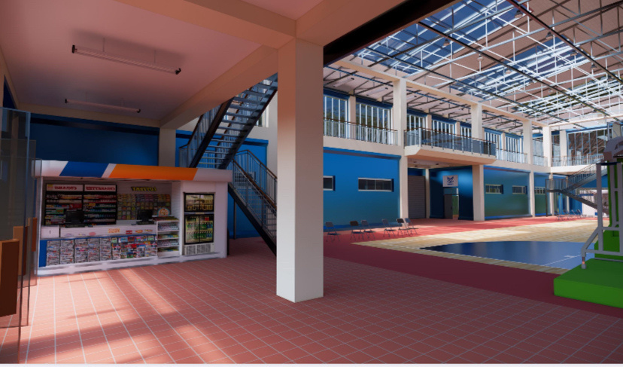

Slide 8
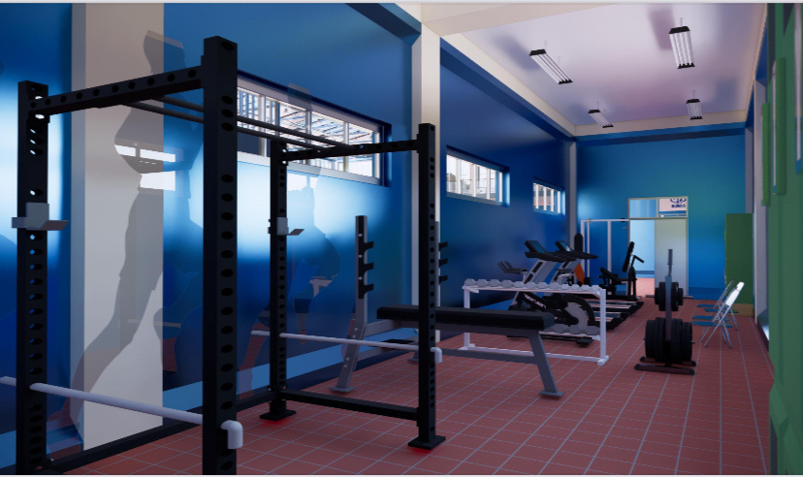

Slide 9
  Prefabricated Bathrooms: One modular restroom unit with two stalls (men’s and women’s), sinks, and basic fixtures, approximately 150-200 sq ft.
  Fans: Two large industrial ceiling fans for air circulation, improving player comfort.
  Remaining Space (~800-1,000 sq ft): Can be used for storage, small spectator seating, or a basic locker area.
4. Additional Amenities

Slide 10
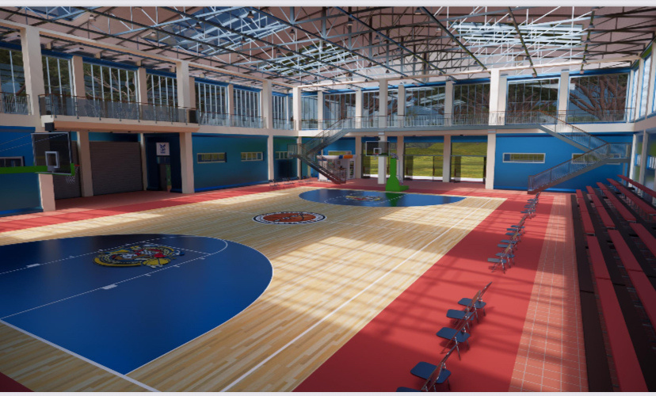

Slide 11
  Structure: Steel frame with insulated metal panels or sandwich panels for energy efficiency
  Height: Minimum 25 ft clearance; 30–35 ft preferable for FIBA
  Roof: Gabled or arched metal roof, possibly with skylights
5. Building Envelope

Slide 12


